Slide 1
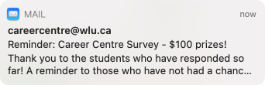
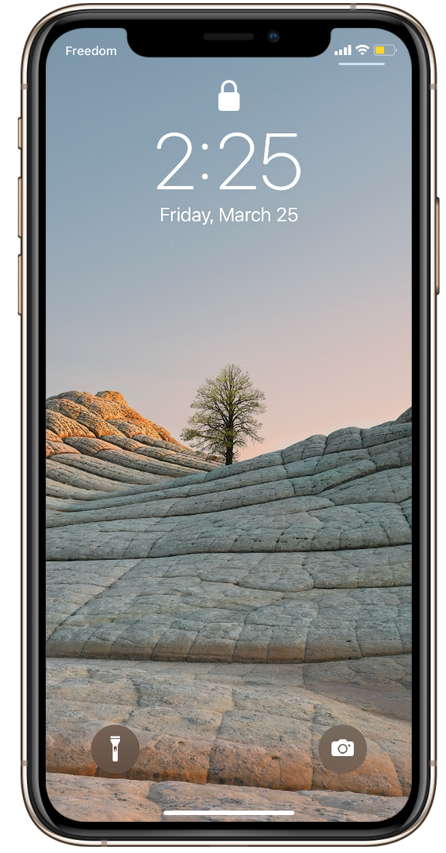
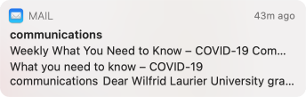
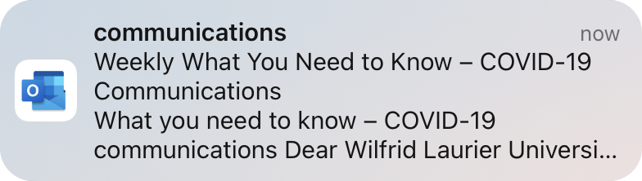

Team NOVA / Unless Design Partners

Slide 2
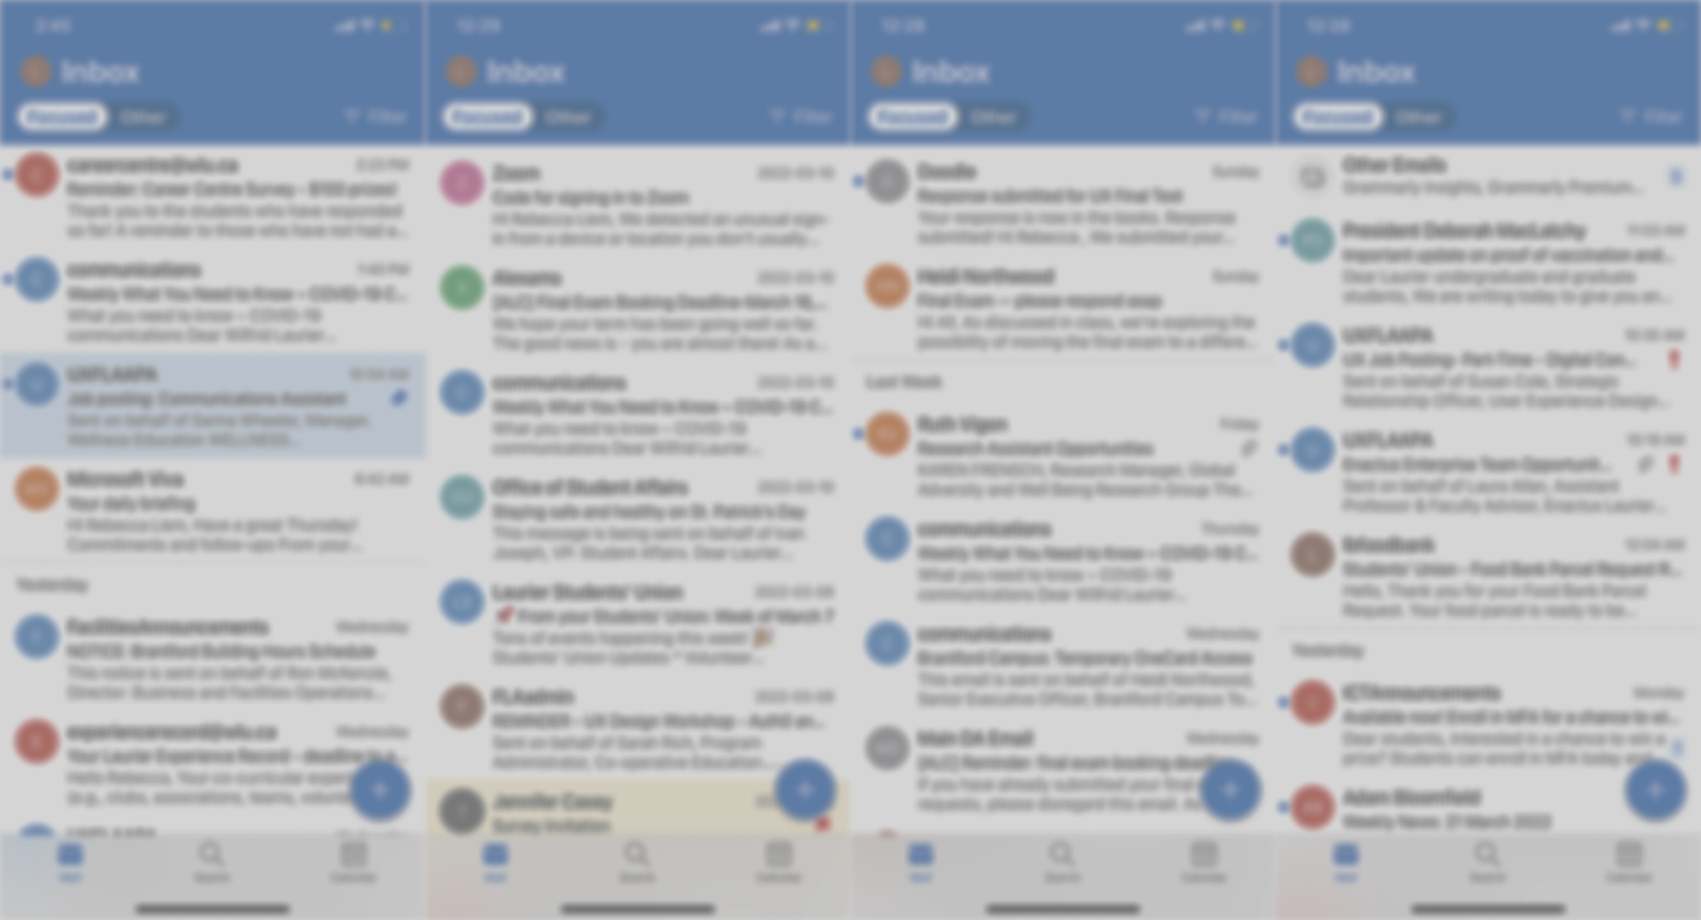
“I’m constantly getting emails from Laurier! I don't even open half of them unless it's urgent” - An overwhelmed Student

Slide 3
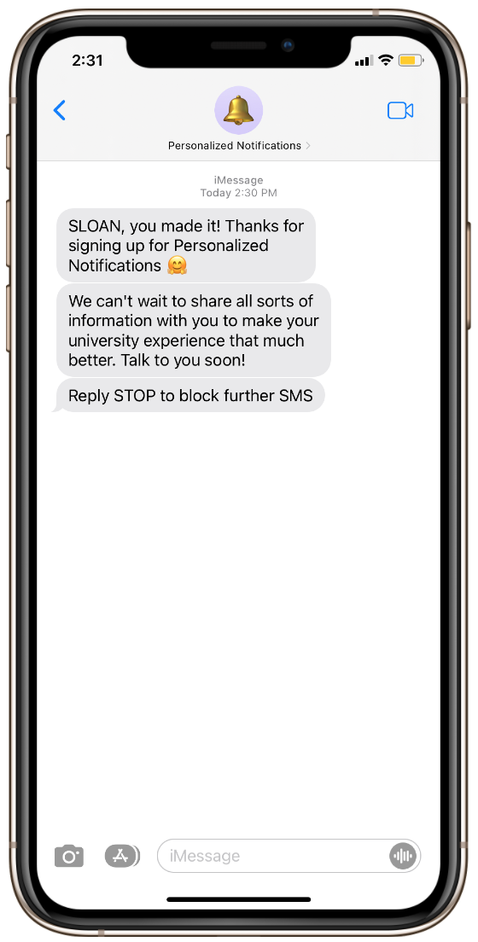
Team NOVA / Unless Design Partners
Personalized Notification System for Laurier Students

Slide 4
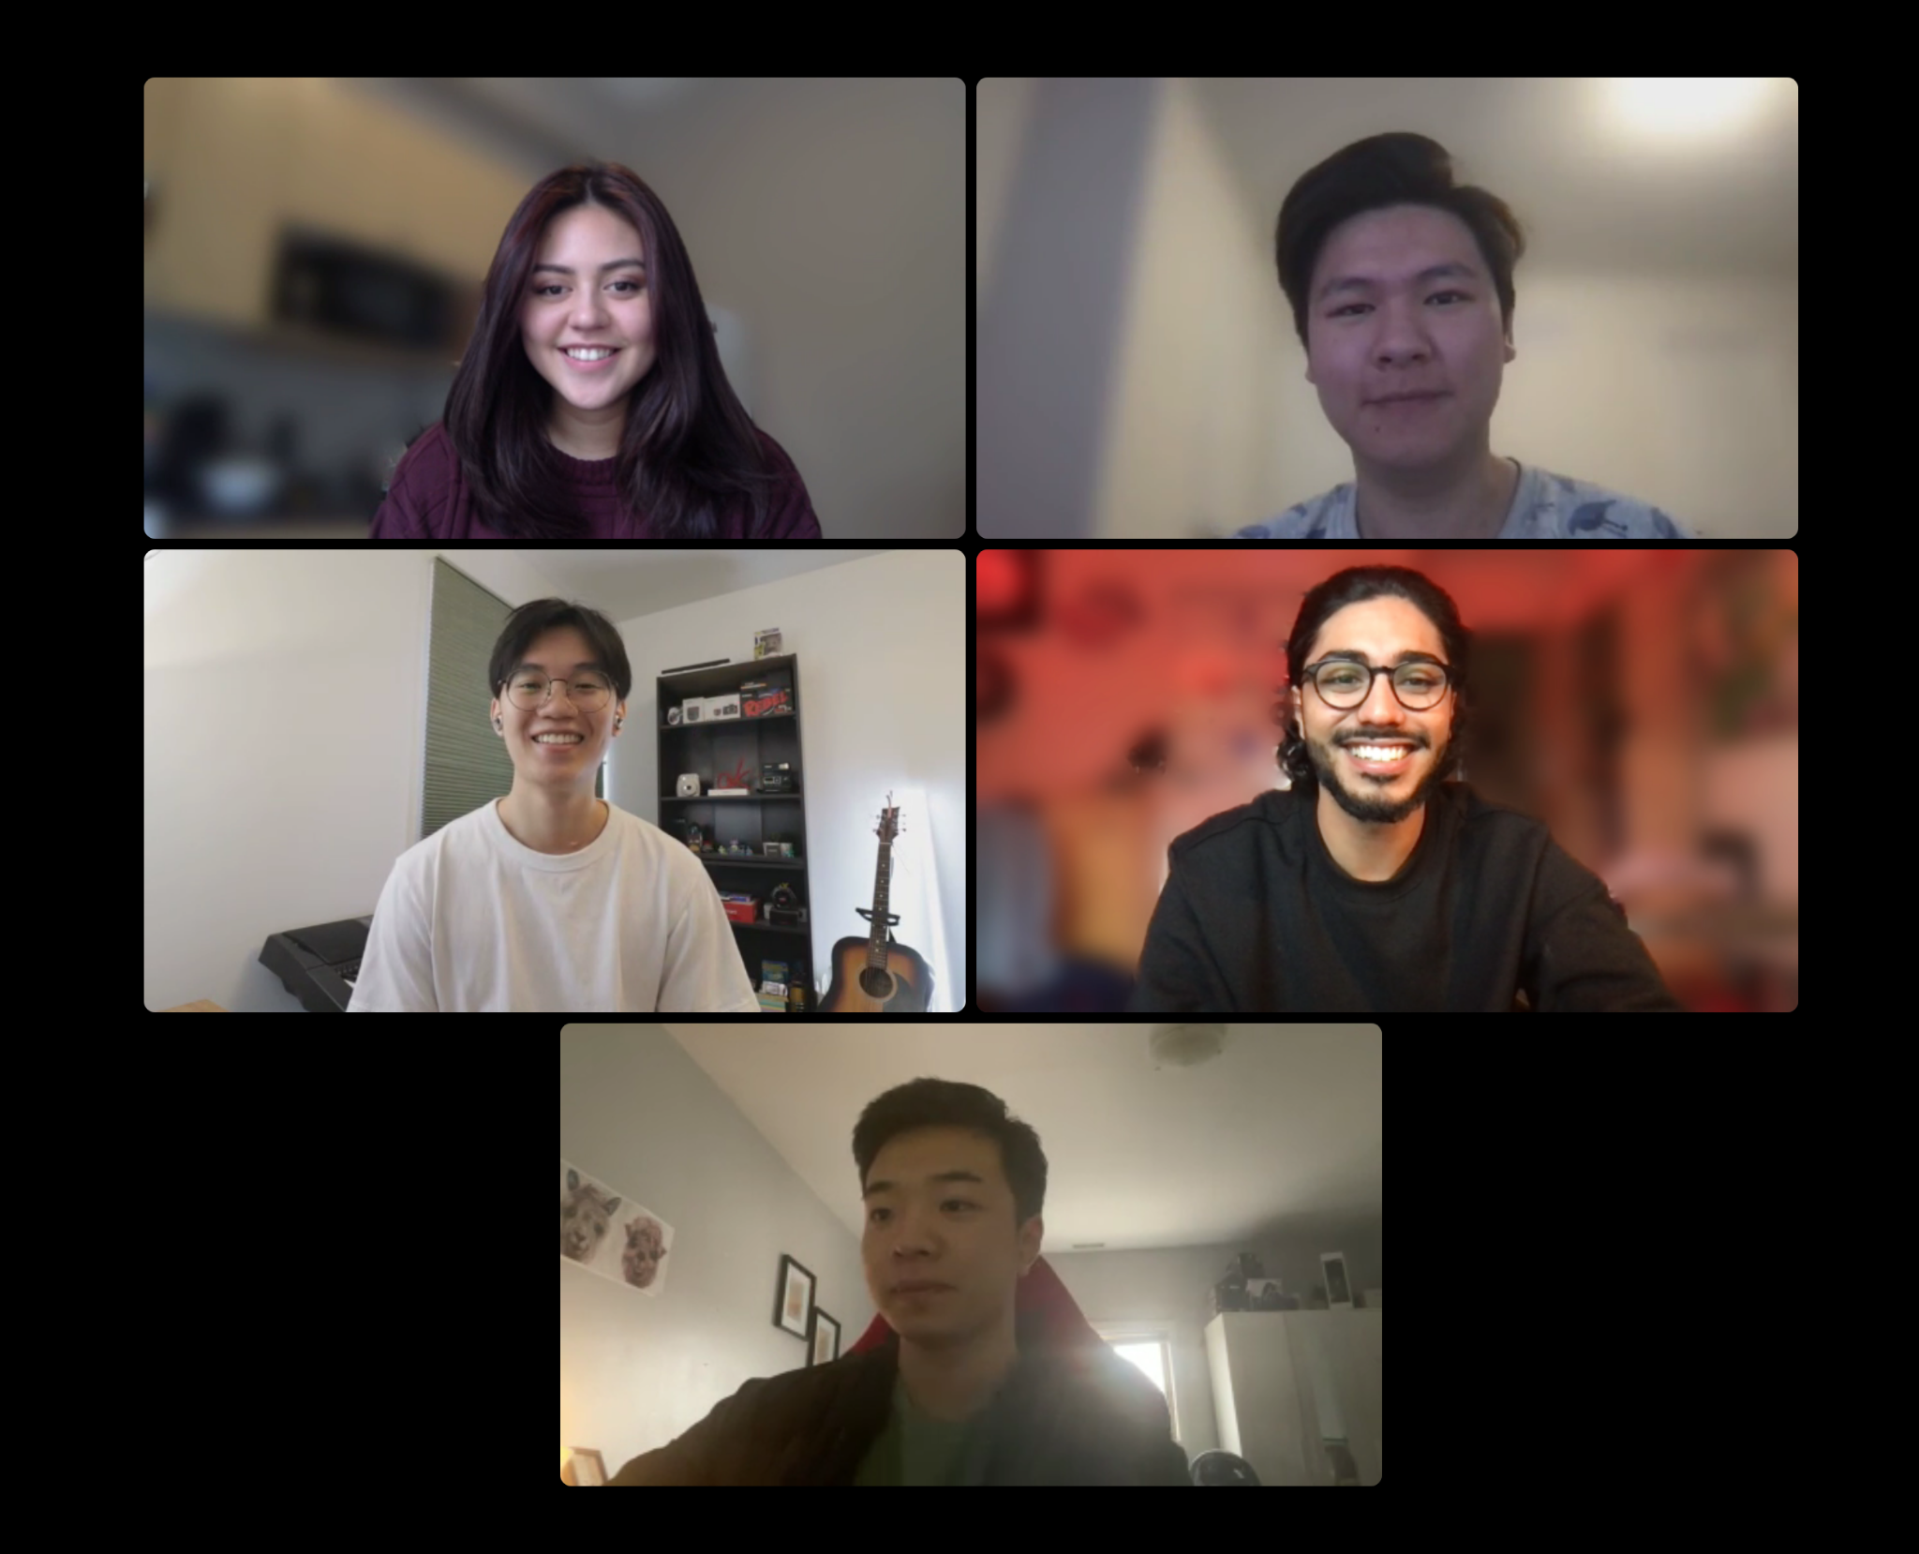
Team NOVA
Becca
Eddie
Edwin
Samer
Zack

Slide 5
Table of Contents
1
2
3
4
BACKGROUND
PROBLEM
What is this project about?
What are we trying to solve?
SOLUTION
IMPLEMENTATION
How our design solves the problem
The feasibility and integration of our solution

Slide 6

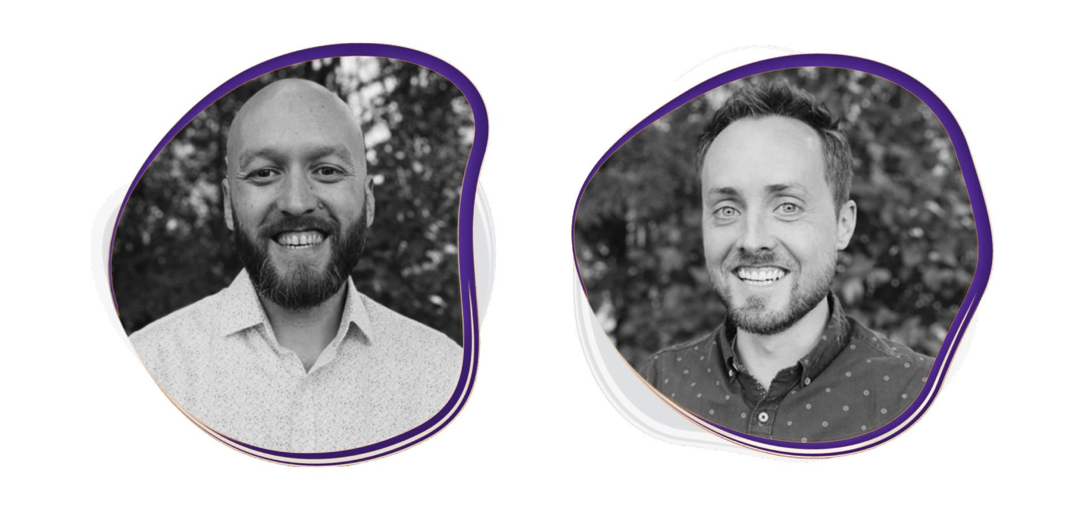
Patrick Boot
Partner
Glen Lombard
Partner

Slide 7
“Relevance of information doesn’t align with the timing of when students need it”
Unless Design Partners, 2021

Slide 8
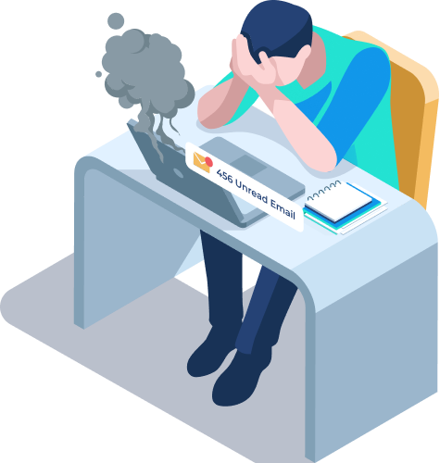
Noise vs. Signal
We learned that:
Students get a lot of notifications and miss Laurier emails
SMS message notifications have the highest view rate
Students prefer text rather than emails

Slide 9
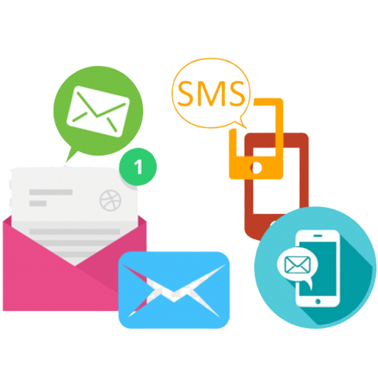
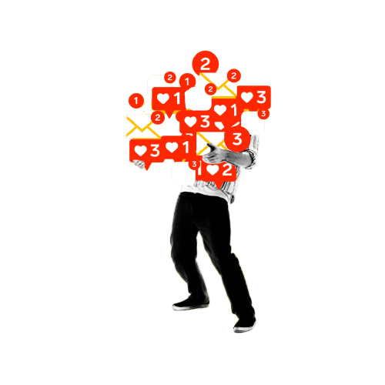
“I’d much rather use texting rather than emails. I get so much info I miss and just don’t look at. I’m always on my phone, never check emails, I’ll always read a text”
“80% of the emails from Laurier don't interest me, or aren't related to me”
Notes:
Grad photo example, it got lost in the newsletter
Technically, the info is related to us, but students are having a hard time receiving the information

Slide 10

How might we ensure that students are getting the information and events they want / need at the appropriate time in a clear way?

Slide 11
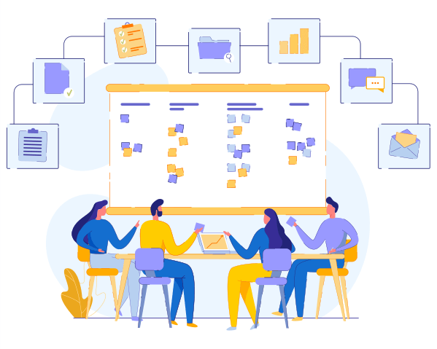
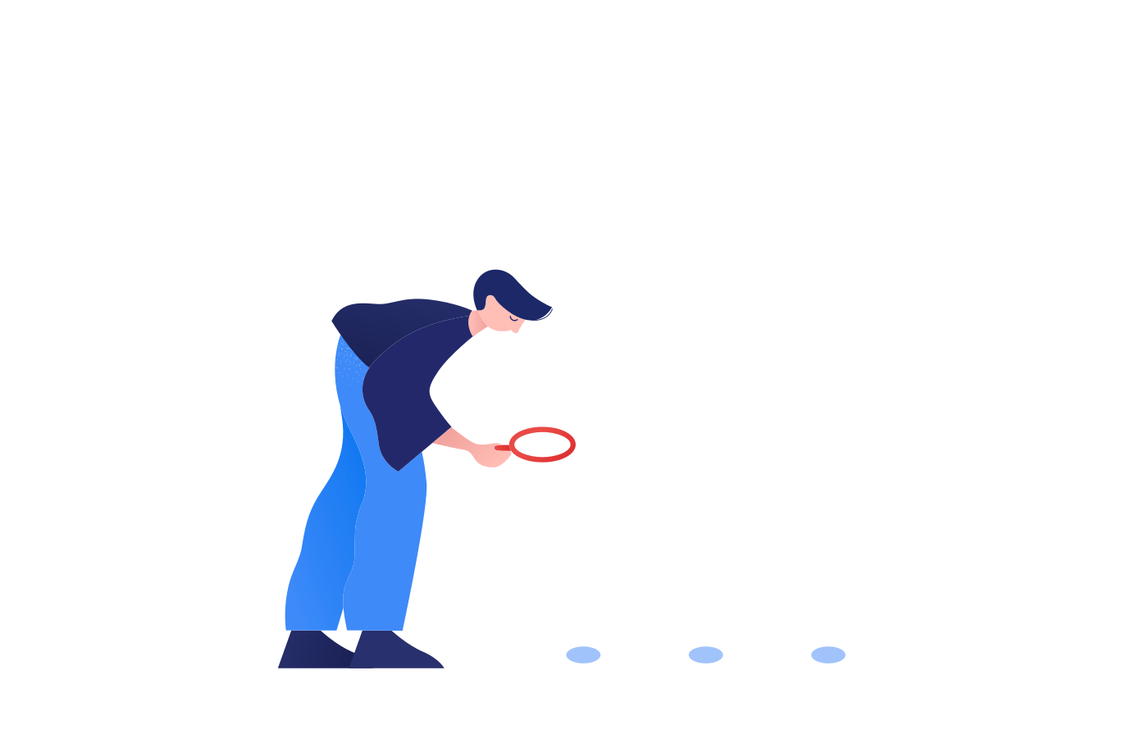
Research
We conducted:
User Interviews
Cognitive Walkthroughs

Slide 12
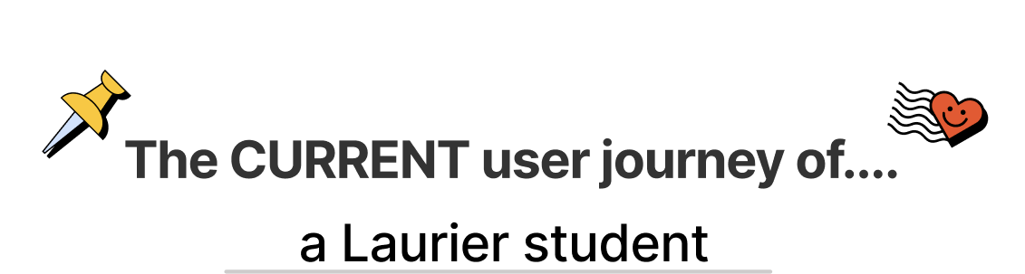
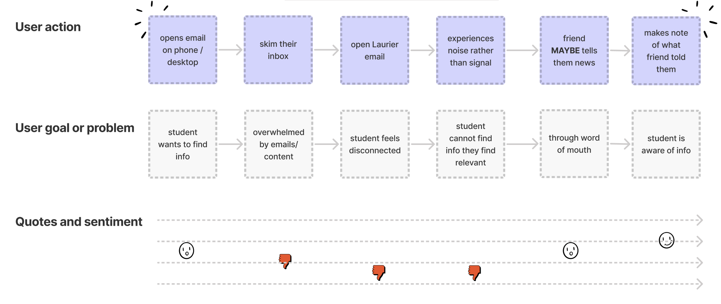

Slide 13
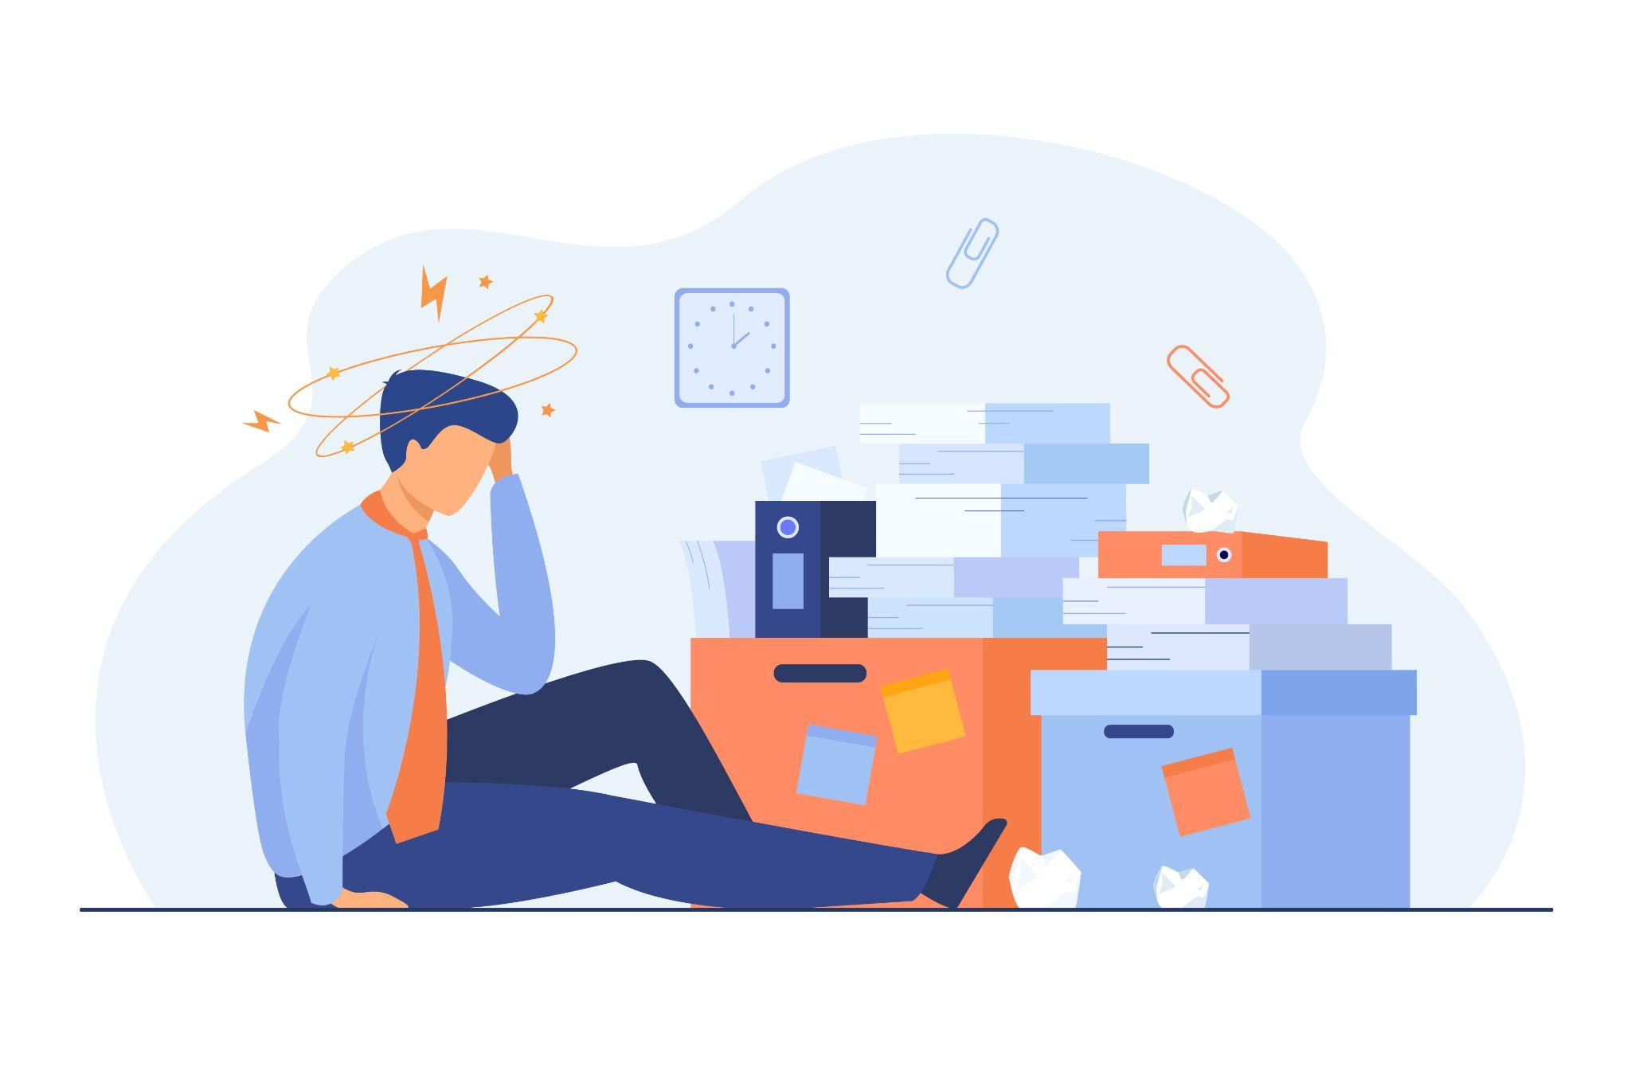
Pain Points
Notification anxiety
More noise than signal
Students feeling disconnected
Another channel of communication
Notes:
<a href="https://www.freepik.com/vectors/bureaucracy">Bureaucracy vector created by pch.vector - www.freepik.com</a>

Slide 14
“I don’t really get news, if I do its from friends, by word of mouth. My friends are often the bearer of news in any connotation”
A Laurier Student

Slide 15
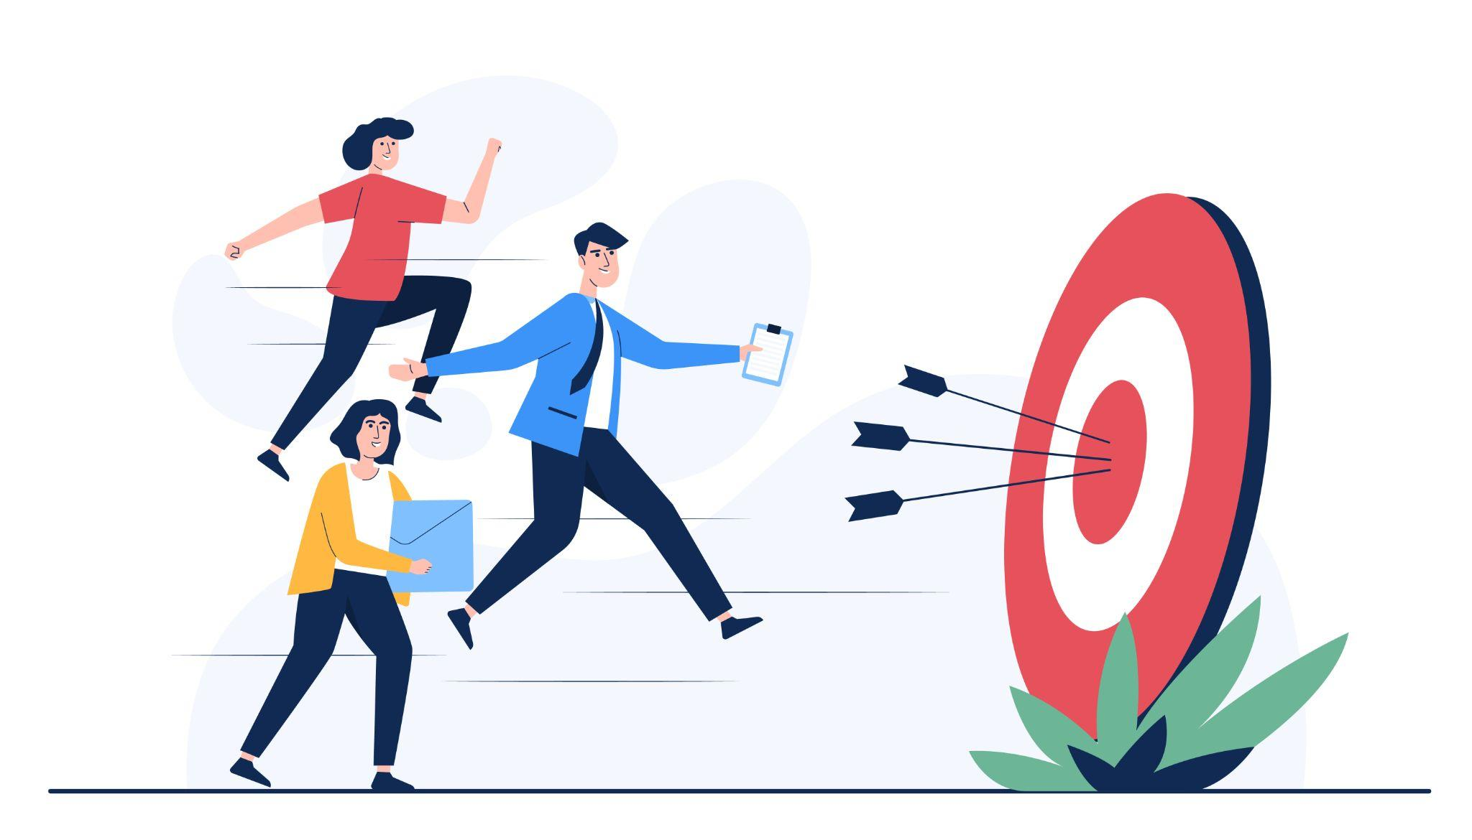
Opportunities
Reduce noise and increase signal
Allow students to filter unwanted / wanted information
Personalized notifications
Notes:
<a href='https://www.freepik.com/vectors/man'>Man vector created by jcomp - www.freepik.com</a>

Slide 16

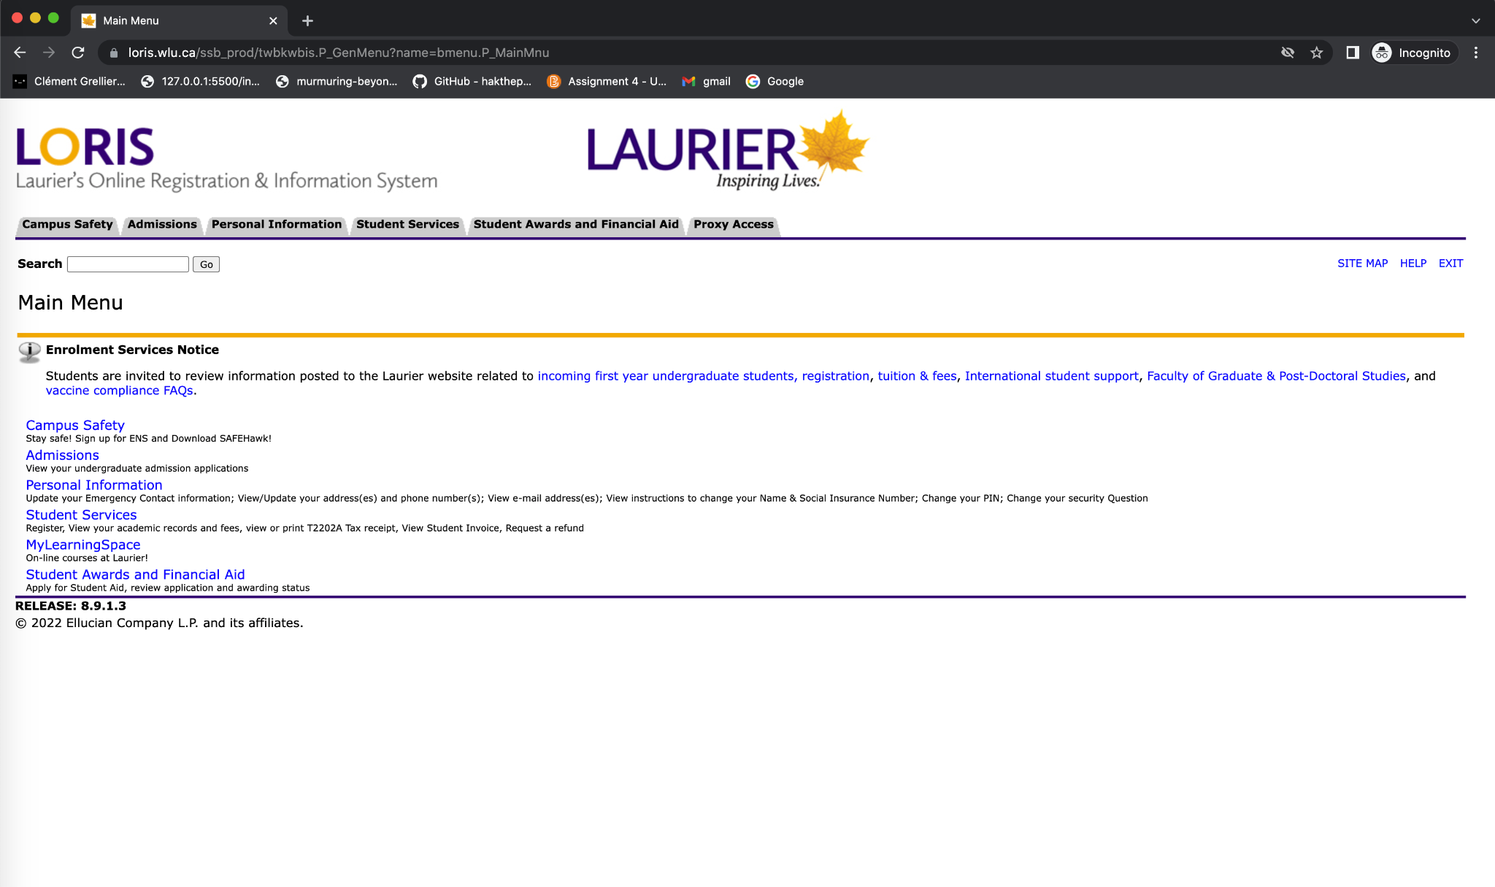
Personalized Notifications

Slide 17


Slide 18
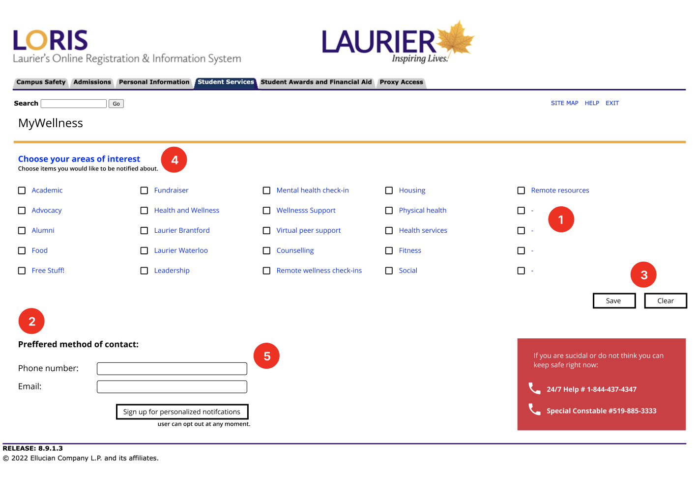





Feedback from Cognitive Walkthroughs
Naming Issues
Visual Issues
Functional Issues
Lack of Explanation and Tips
Prototype Usability Issue

Slide 19
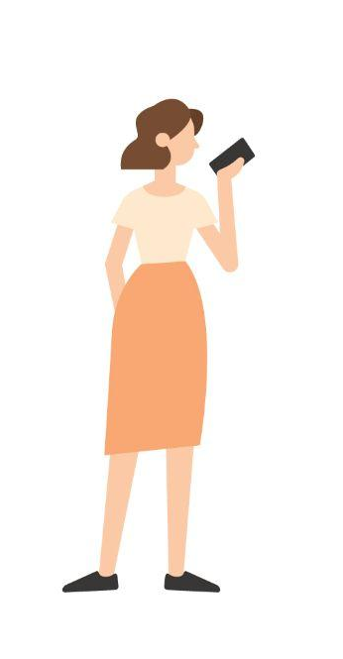

Sender
Receiver
(Laurier)
(Students)
Notes:
<a href="https://www.freepik.com/vectors/people">People vector created by pikisuperstar - www.freepik.com</a>

Slide 20
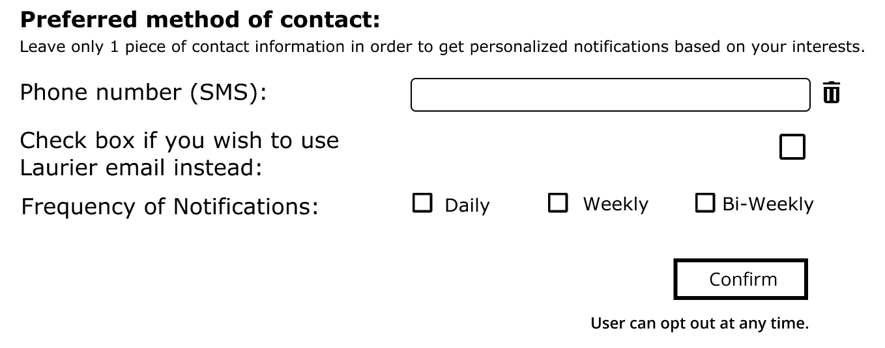
Notification anxiety
Students receive too many emails and do not want to look at them
Frequency control helps alleviate notification anxiety

Slide 21
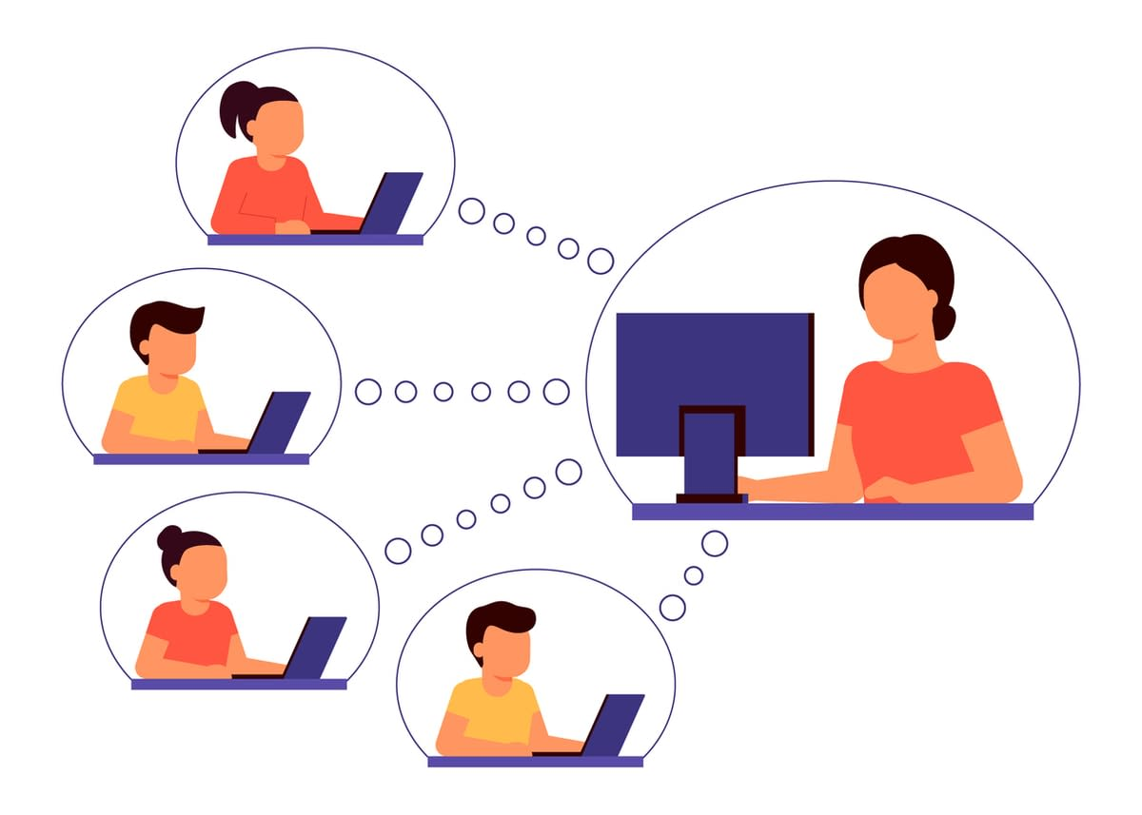
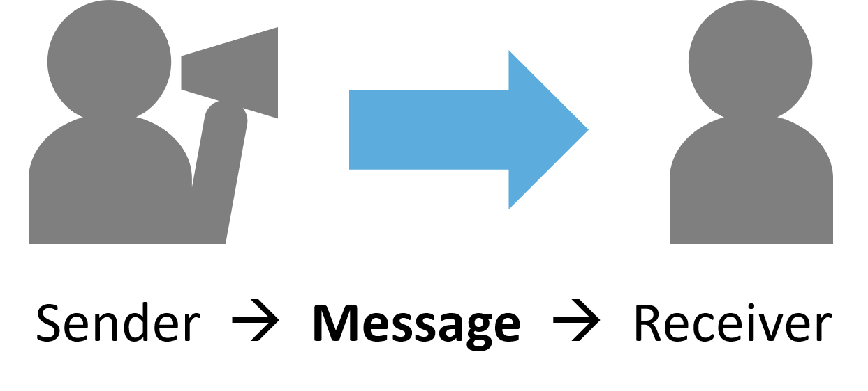
What we are doing at Nova
Bringing the receiver back online
Getting the sender and receiver back together
Aiming to maximize signal not noise
Notes:
<a href="https://www.freepik.com/vectors/technology">Technology vector created by storyset - www.freepik.com</a>

Slide 22


Implementation
How will students find out about this?
Wellness center ambassador
MyLS Notification
O-Week Introduction
Laurier Newsletters

Slide 23


Implementation
How will our solution be implemented?
Leveraging existing mental models
Integrating with existing campus technology

Slide 24

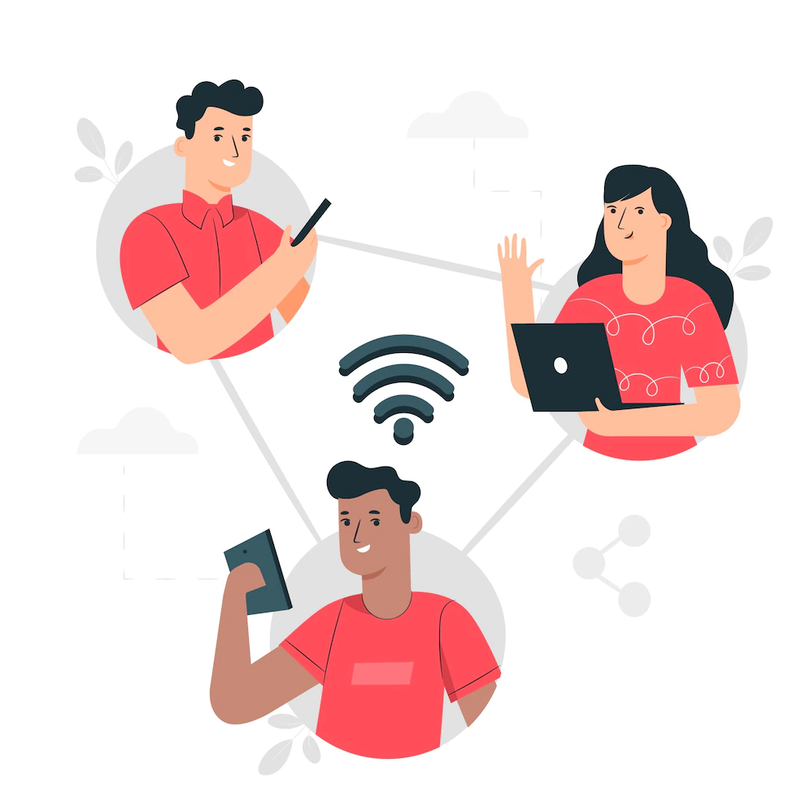
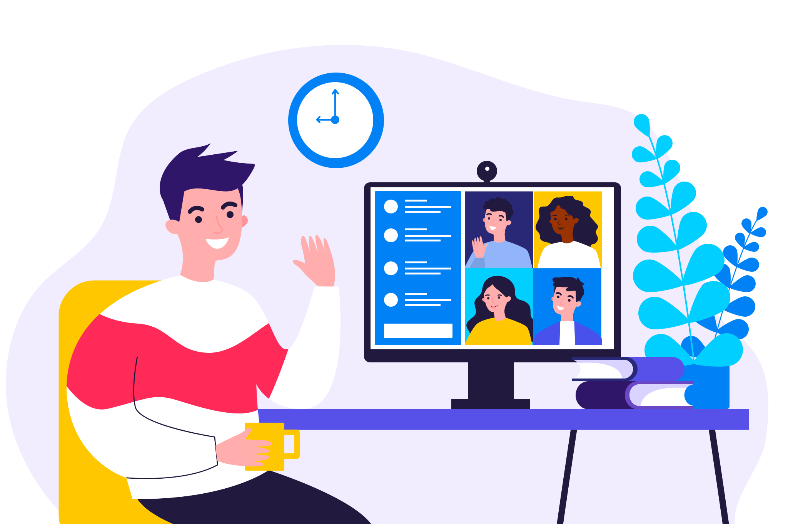
Team Nova’s Impact
Increase in overall student experience
Students feel connected
Alleviate students anxiety
Increase signal on important information
Notes:
<a href="https://www.freepik.com/vectors/technology">Technology vector created by storyset - www.freepik.com</a>

Slide 25
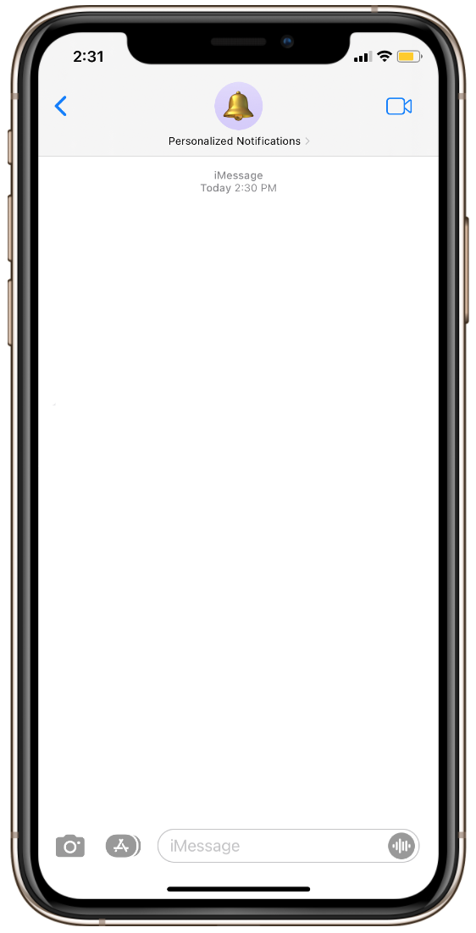
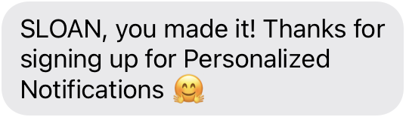
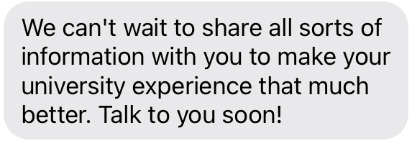

Thank You!
Personalized Notification System for Laurier Students

Slide 26
Resources
<a href="https://www.freepik.com/vectors/bureaucracy">Bureaucracy vector created by pch.vector - www.freepik.com</a>
<a href="https://www.freepik.com/vectors/people">People vector created by pikisuperstar - www.freepik.com</a>
<a href="https://www.freepik.com/vectors/technology">Technology vector created by storyset - www.freepik.com</a>

